Slide 1
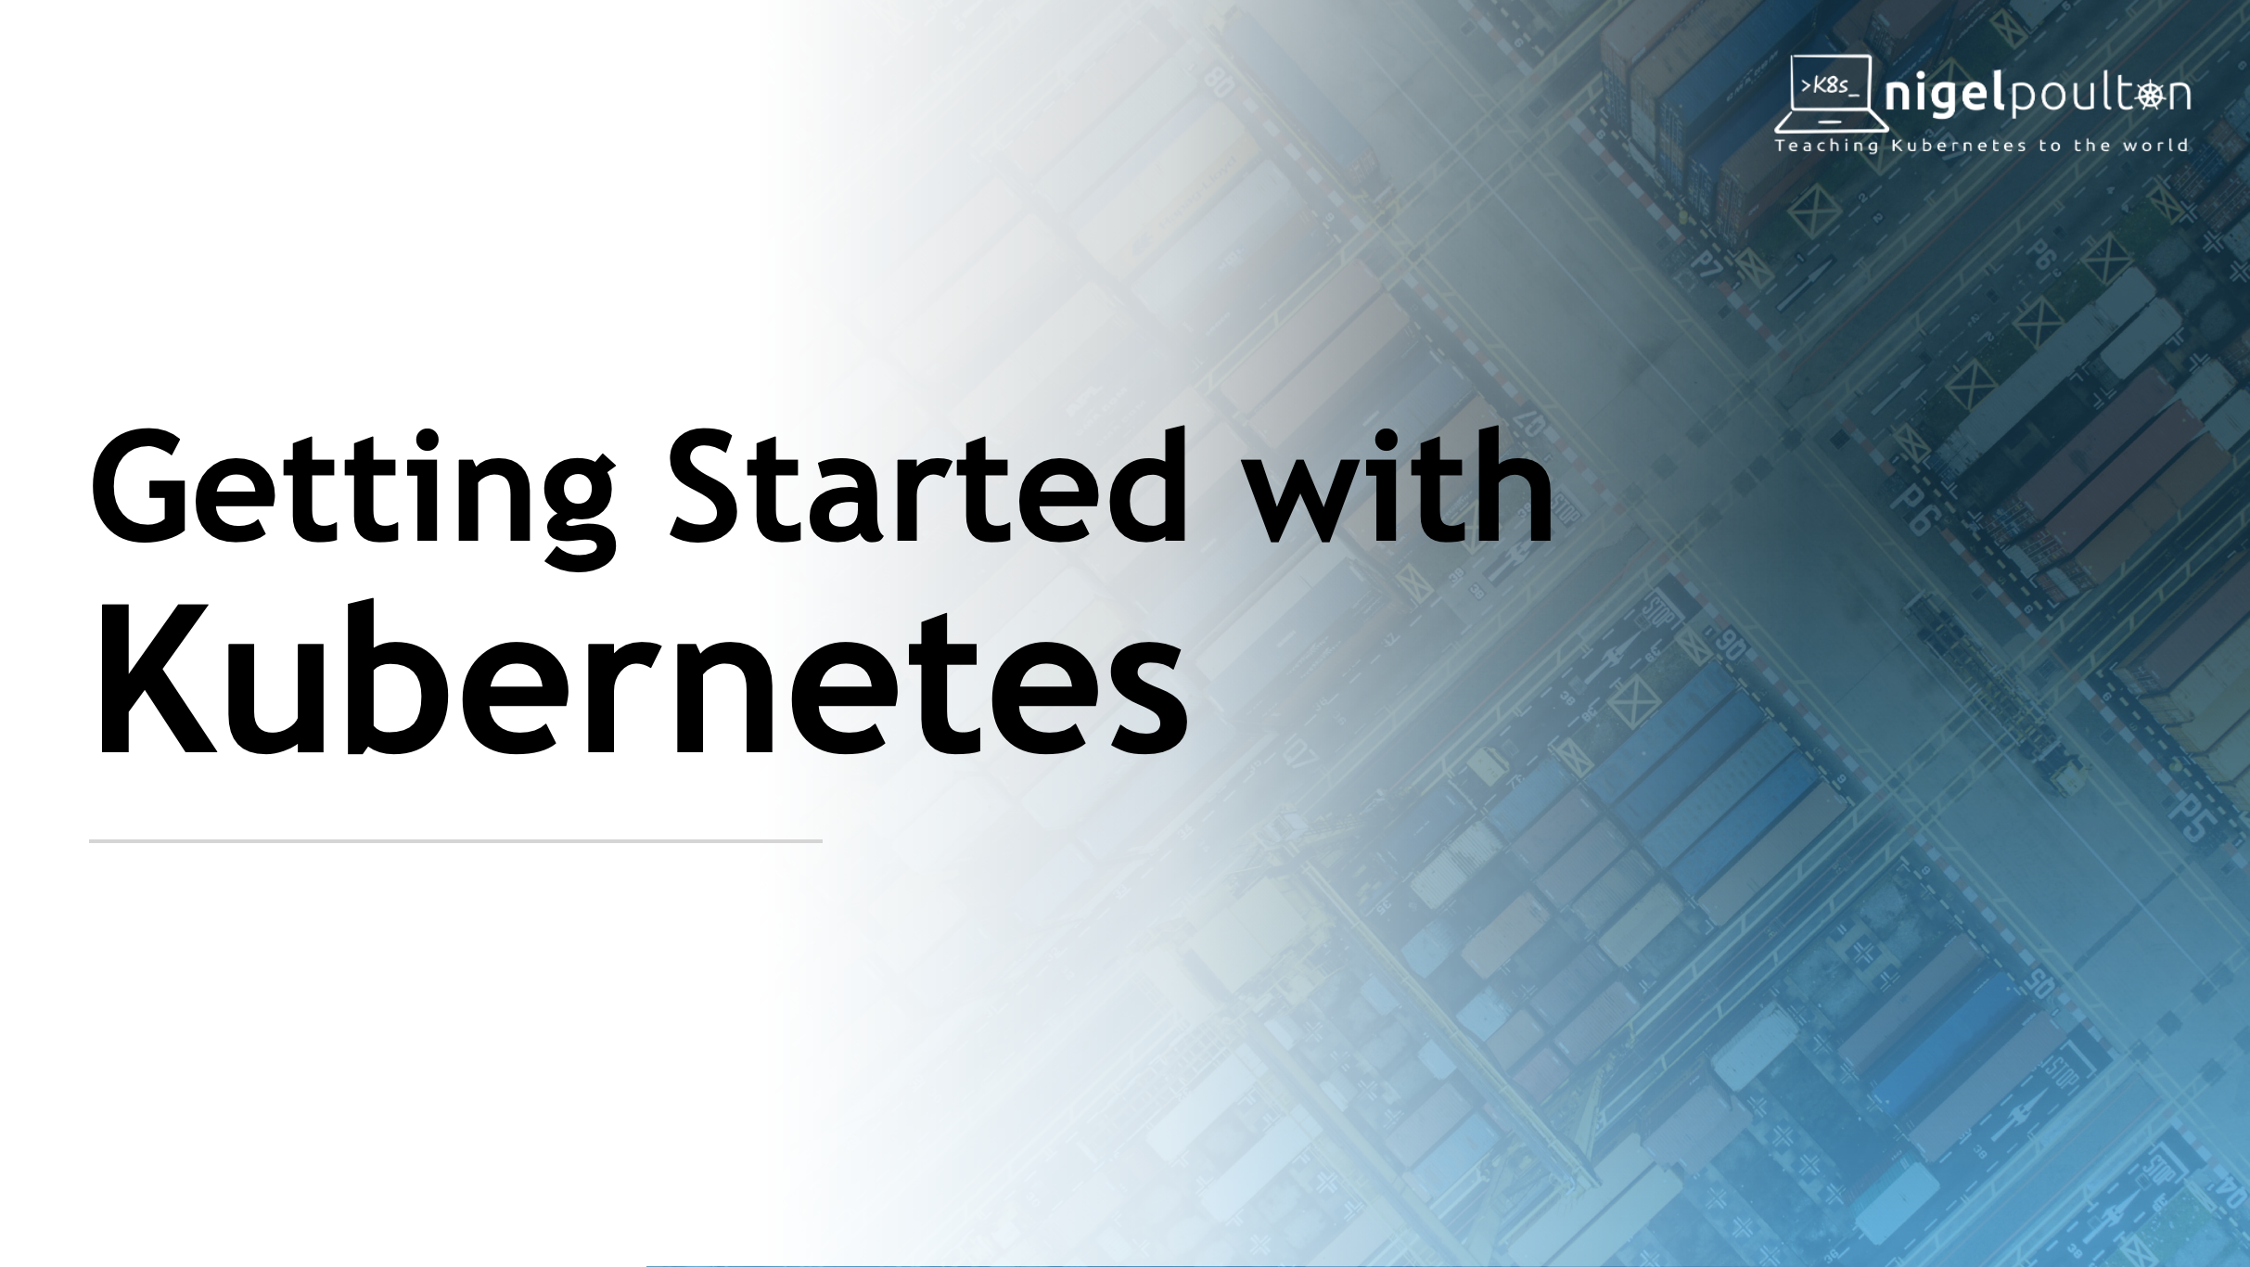

Slide 2

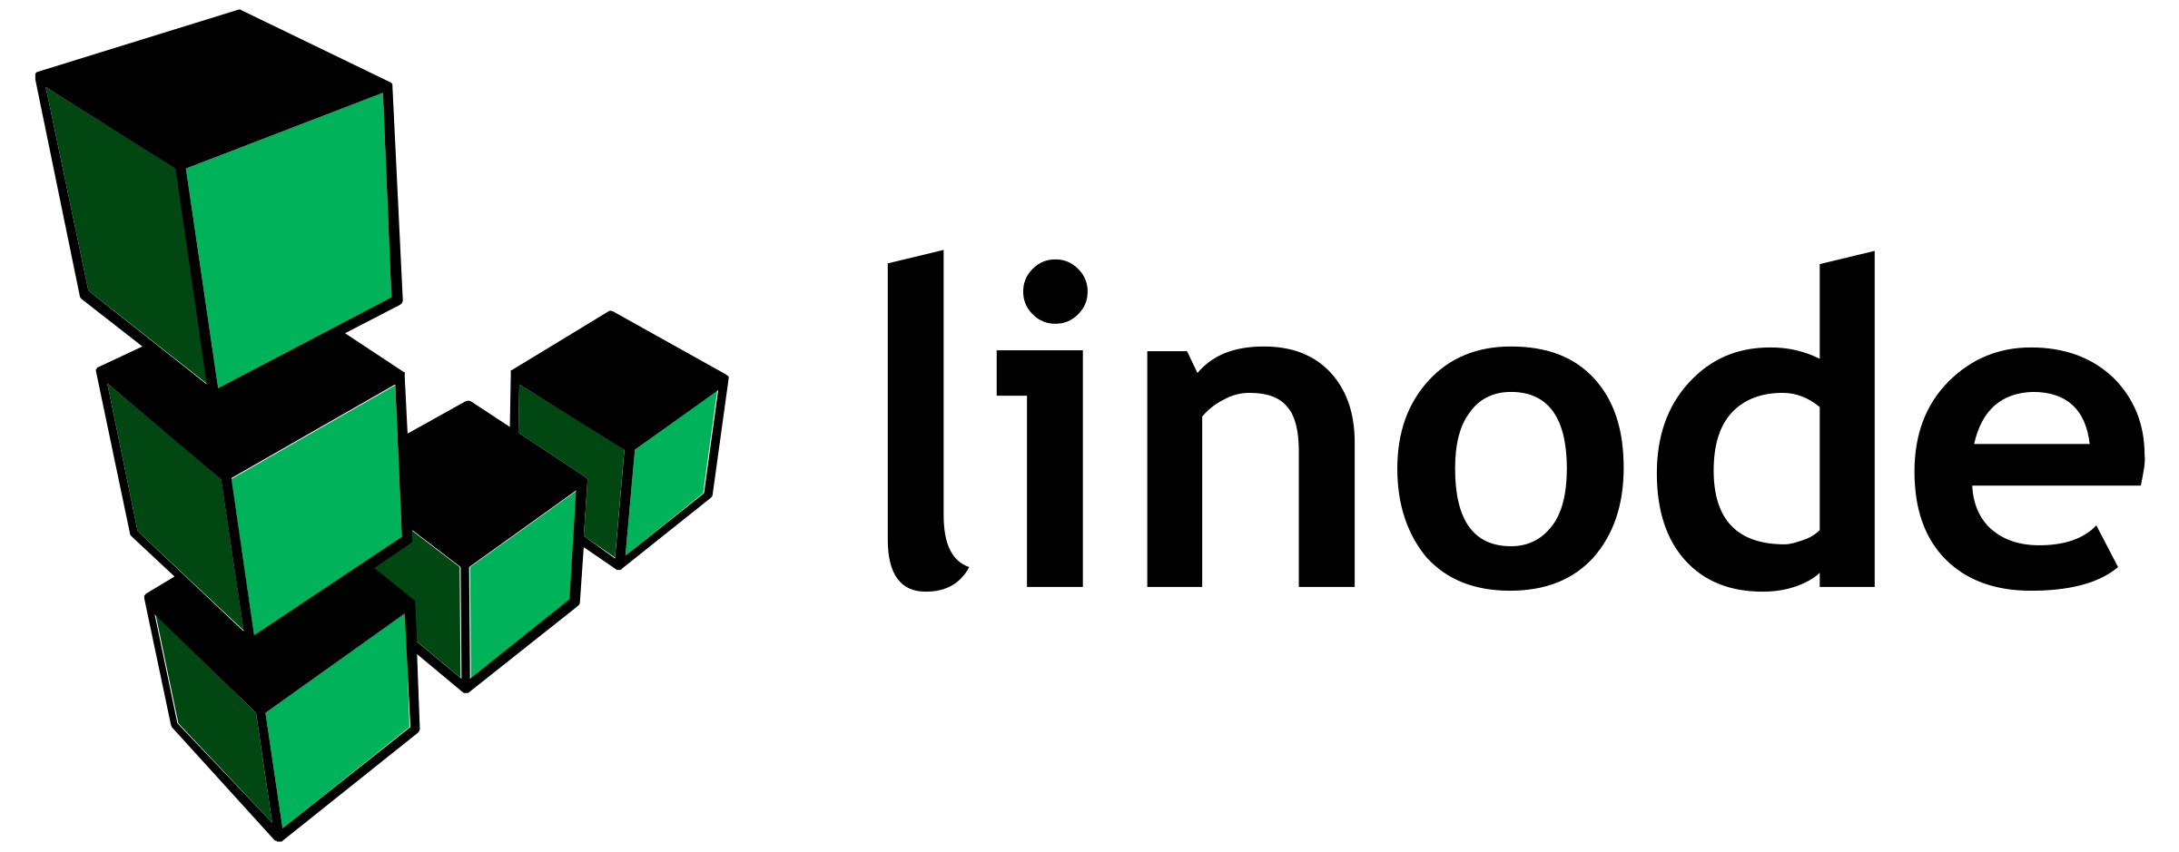

Slide 3

WiFi: Hhonors meeting
Choose “I have a promo code”
Password: Fort1022
https://github.com/nigelpoulton/gsk-workshop

Slide 4
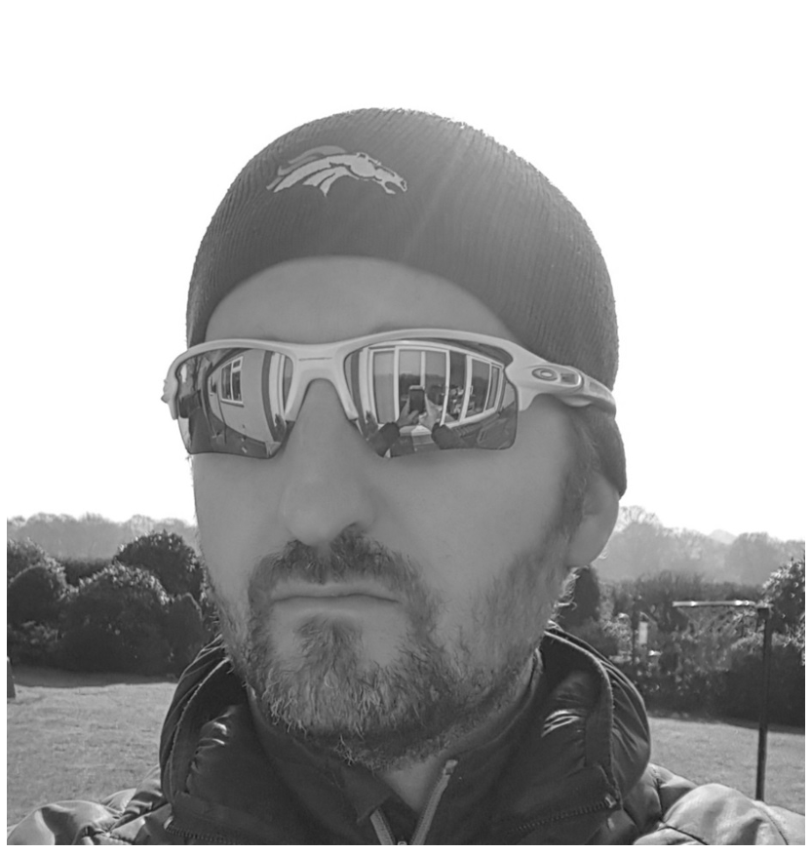
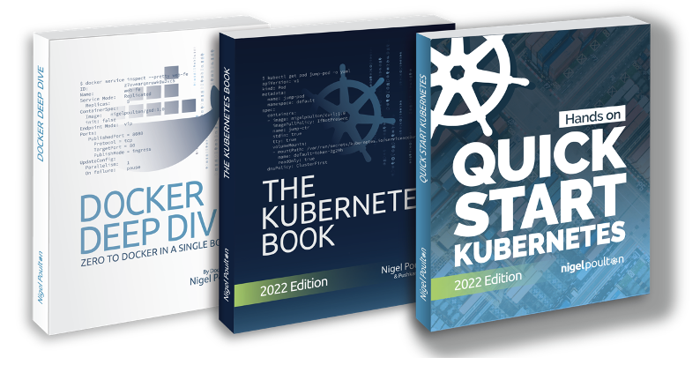

@

Slide 5
Ask Questions!

Slide 6
Working With Containers
Why Kubernetes
Deploying Apps to Kubernetes
Exposing Apps on Networks
Cloud Native Superpowers
Open Q&A
Agenda

Slide 7

Working With Containers

Slide 8





App
/
/
/
OS (kernel)
PID 0
PID 0
PID 0
Hardware
VM
VM
VM

Slide 9
App
App
App
App
App
App
App
OS
OS
OS
/
/
/
OS (kernel)
PID 0
PID 0
PID 0
Hardware
Container model
Smaller
Faster
Lighter weight
VM
VM
VM
VM model
Better app density

Slide 10

</>
lib x
lib y
Build into container image
Host in a registry
Run in production

Slide 11
Demo

Slide 12
Questions…

Slide 13
Why Kubernetes

Slide 14
Kubernetes
“An orchestrator of microservices applications and the
OS of the cloud”

Slide 15
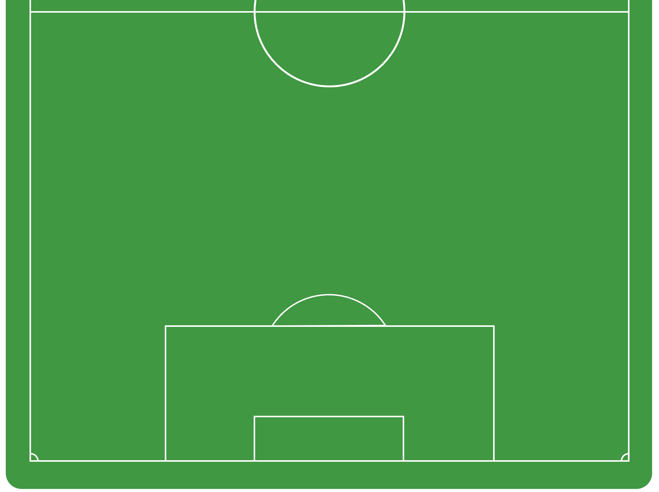
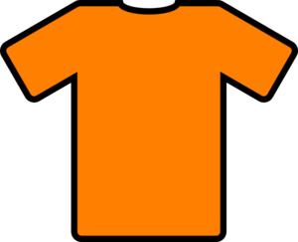


RW
CB
Coach
LB
CM
CM
CB
CF
GK
RB
DM
LW

Slide 16
CF
LW
RW
CM
CM
DM
Coach
LB
RB
CB
CB
GK

Slide 17
CF
LW
RW
CM
CM
DM
Coach
LB
RB
CB
CB
GK

Slide 18
CF
LW
RW
CM
CM
DM
Coach
LB
RB
CB
CB
GK

Slide 19
CF
CF
LW
RW
CM
CM
DM
LB
RB
Coach
CB
GK

Slide 20

db
WWW
WWW
WWW

Slide 21
App
WWW
WWW
WWW
db

Slide 22
App
WWW
WWW
WWW
db

Slide 23
App
WWW
WWW
WWW
db

Slide 24
App
WWW
WWW
WWW
db

Slide 25
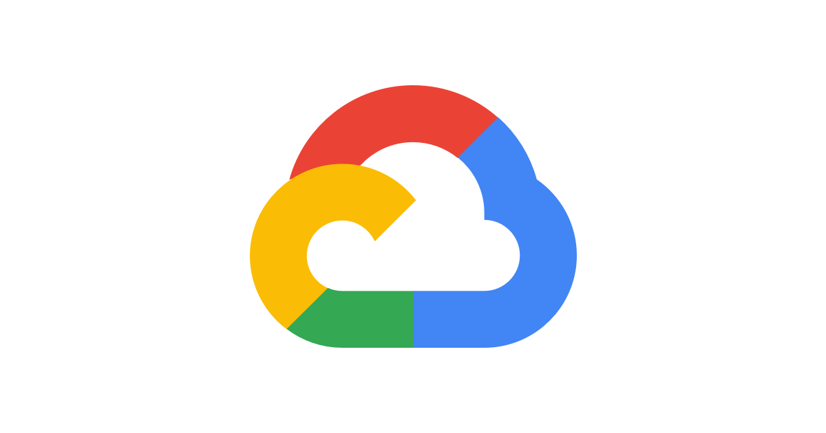



App
WWW
WWW
WWW
db
K8s
K8s
K8s
K8s

Slide 26
Questions…

Slide 27
Deploying Apps to Kubernetes

Slide 28

Pod
. . .

Slide 29
Pod
. . .

Slide 30

Pod
xyz
Labels and annotations
Resource limits
Security policies
Restart policies
Probes
Advanced scheduling
<>
><
. . .

Slide 31
Pod
Pod
Pod
Pod
Pod
Pod
Pod
Pod
Pod
VM
VM
VM
VM
VM
Fe
Fe
Fe
Fe
Fe
Kubernetes cluster

Slide 32
Pod
Pod
Pod
Pod
Pod
Pod
Pod
Pod
Pod
VM
VM
VM
VM
VM
Fe
Fe
Fe
Fe
Fe
Kubernetes cluster

Slide 33
App
WWW
db

Slide 34
App
Pod
Pod
Pod
WWW
Pod
Pod
Pod
Pod
Pod
Pod
db

Slide 35
App
Pod
Pod
Pod
Pod
WWW
WWW
Pod
Pod
Pod
Pod
Pod
Pod
db

Slide 36
Demo

Slide 37
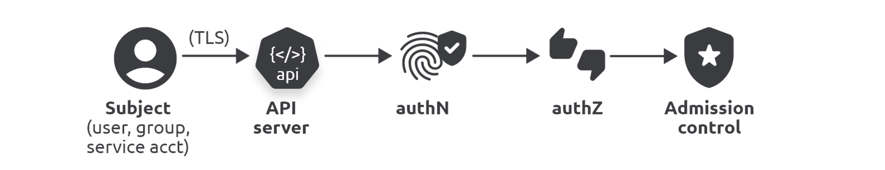
$ kubectl apply -f pod.yml
$ kubectl get pods --watch
$ kubectl describe pod hello-pod

Slide 38
Questions…

Slide 39
Exposing Apps on Networks

Slide 40
Client
¯\_(ツ)_/¯
Pod
Pod
Pod
Pod
Pod
Pod
Pod

Slide 41
Client
Service
Stable name & IP
Label selector: blue Pods
Pod
Pod
Pod
Pod
Pod
Pod
Pod

Slide 42
Client
Service
Stable name & IP
Label selector: blue Pods
Pod
Pod
Pod
Pod
Pod
Pod
Pod

Slide 43
Demo

Slide 44
Client
Cloud LB
Service
Pod
Pod
Pod
Pod

Slide 45
Questions…

Slide 46
Cloud Native Superpowers

Slide 47
Pod

Slide 48
Pod
Scheduling
Resources
Policies
Probes…

Slide 49
Deployment
Pod
Scheduling
Resources
Policies
Probes…
Scaling
Self-healing
…

Slide 50
Demo

Slide 51

$ kubectl
repl
5
Kubernetes

Slide 52
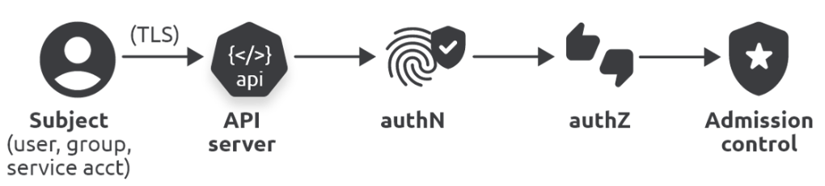
$ kubectl
repl
10
Kubernetes
repl
5
repl
5
Controller
Desired state
Actual state

Slide 53
$ kubectl
Kubernetes
repl
10
repl
5
Controller
Desired state
Actual state

Slide 54
$ kubectl
Kubernetes
repl
10
repl
5
Controller
Desired state
Actual state

Slide 55
$ kubectl
Kubernetes
repl
10
repl
10
repl
5
Controller
Desired state
Actual state

Slide 56
Demo

Slide 57

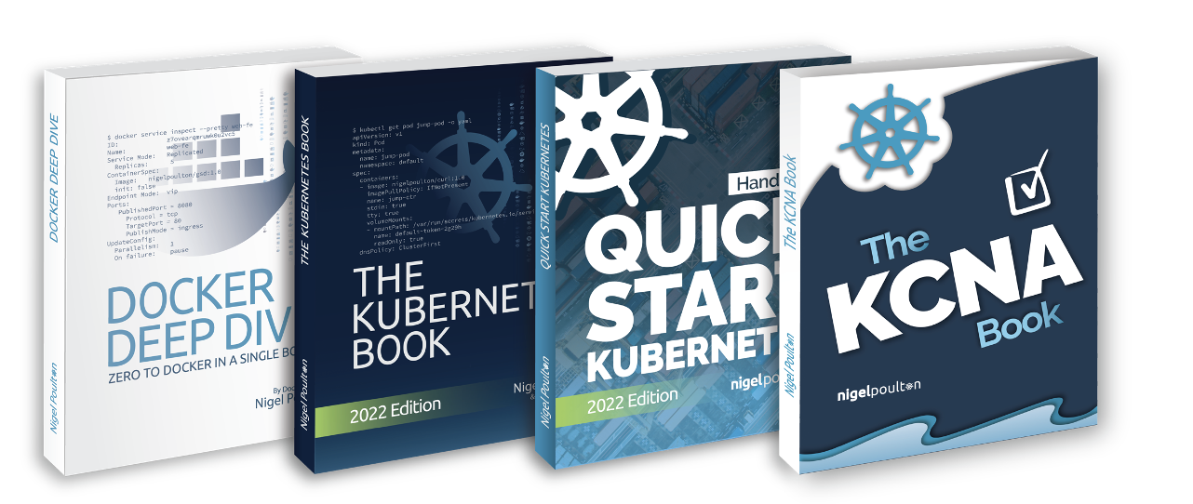
@
Add text/info here
Q&A

Slide 58
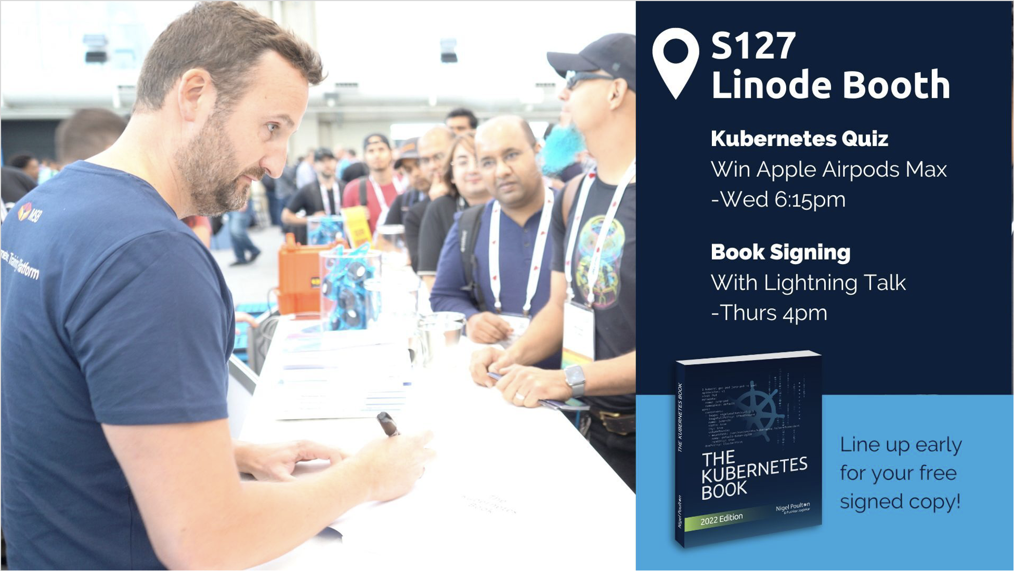

Slide 59
Which of the following says “Kubernetes” in Klingon?
A. Kumbernaughts
B. Kubernetes
C. Docker
D. WebAssembly

Slide 60

Who’s logo?
B. Kubernetes
A. Thanos
B. Prometheus
C. Cilium
D. Crossplane

